Slide 1
AGRICULTURE
Agriculture is the science of growing crops and raising animals to meet the food ,fiber ,fuel,and others needs of humans .It includes many arrears, such as soil conservation, pest management, and mechanices

Slide 2
The Following are the topics of Agriculture:
Technical Transformation in Agriculture
Organic Farming And Organic Food
Socialization of Technology in Agriculture
Diversification in Agriculture
Large Population and Less Population
Sustainable Agriculture For Food
Farm Power And Energy In Agriculture

Slide 3
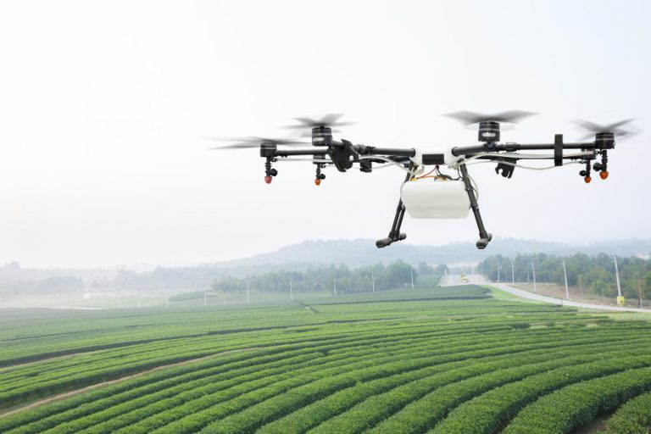
Technical Transformation in Agriculture
Technological transformation refers to the application of modern agricultural technology to increase productivity. Agriculture production can be supported by the adoption of modern farming technologies such as agriculture equipment, better-quality seed varieties, and fertilizers based on th e inorganic compounds

Slide 4
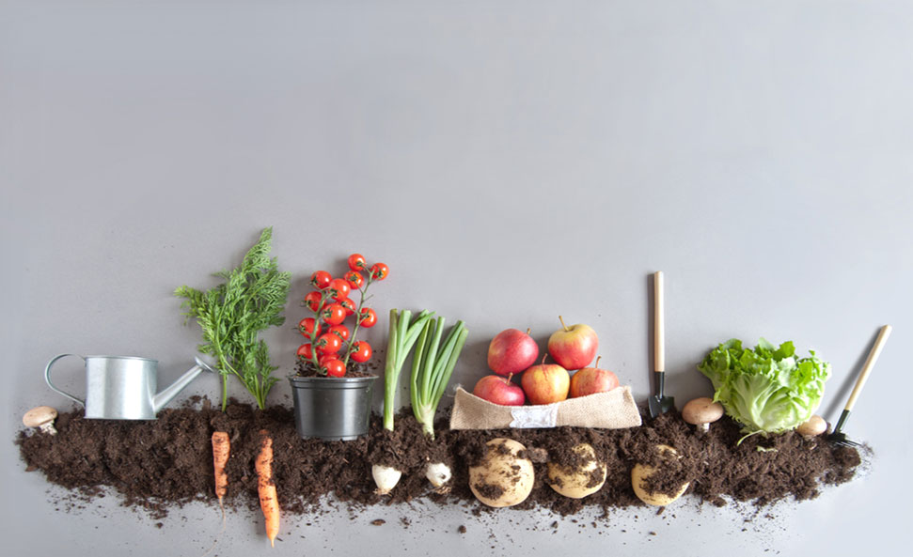
Organic Farming And Organic Food
Organic farming can be defined as an agricultural process that uses biological fertilisers and pest control acquired from animal or plant waste. Organic farming was actually initiated as an answer to the environmental sufferings caused by the use of chemical pesticides and synthetic fertilisers.

Slide 5
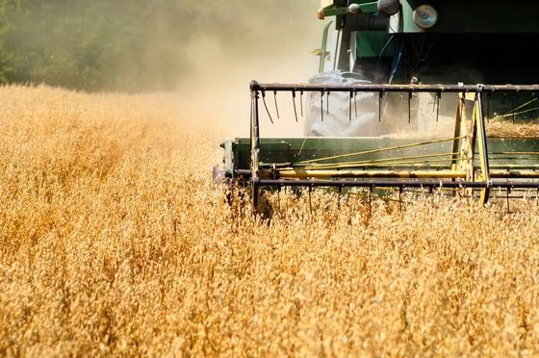
Socialization Of Technology In Agriculture
Technological Socialization in agriculture refers to the development of technologies that are compatible to the social system. This compatibility means how well they fit into the existing values and beliefs, the religious faith and cultural set up of the system in which the technologies have to play their role.

Slide 6
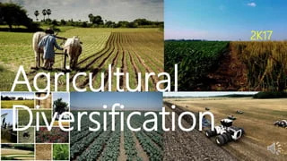
Diversification of Agriculture
Agricultural diversification occurs when more species, plant varieties or animal breeds are added to a given farm or farming community, and this may include landscape diversification – different crops and cropping systems interspersed in space and time.

Slide 7
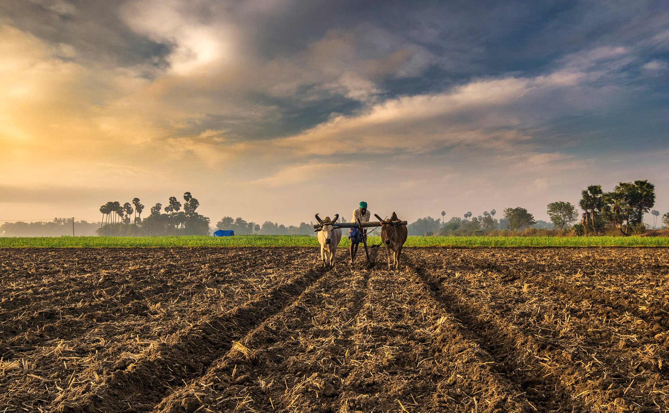
Large Population And Less Agriculture
Food production depends on croplands and water supply, which are under strain as human populations increase. Pressure on limited land resources, due to population growth, can mean expansion of cropland. This lead to destruction of vital forest resources or overexploitation of arable land.

Slide 8
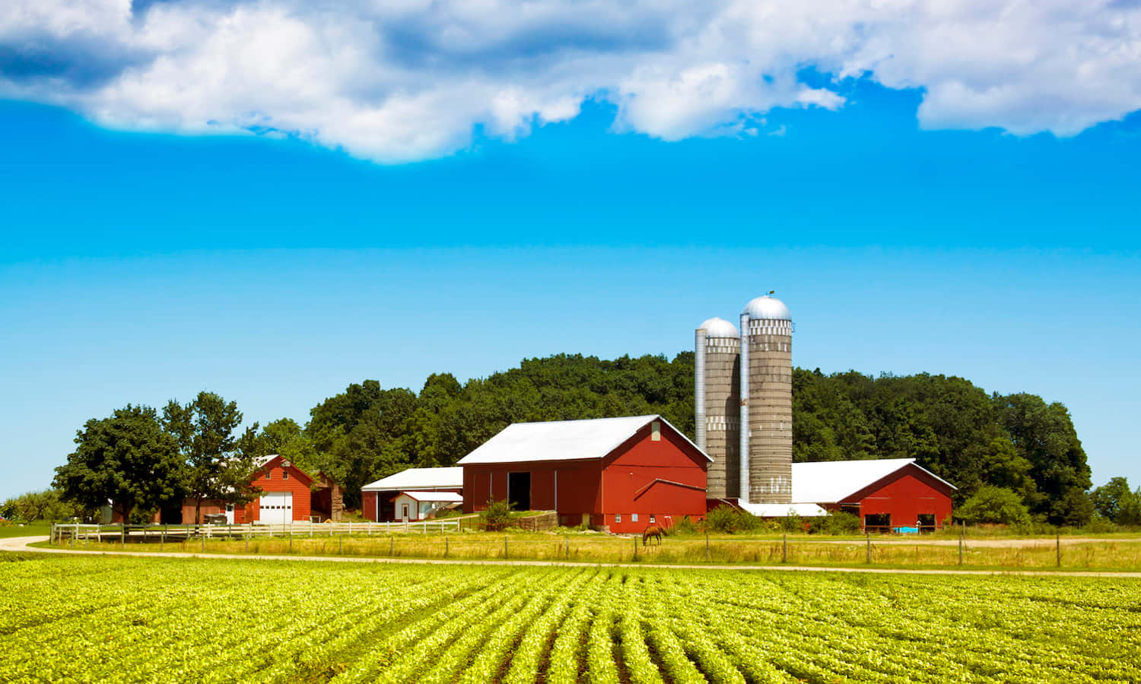
Farm Power and Energy in Agriculture
.
Farm power is used for operating different types of machinery like tillage, planting, plant protection, harvesting and threshing machinery and other stationary jobs like operating irrigation equipment, threshers/ shellers / cleaners/ graders, etc.

Slide 9
THANK YOU

